Slide 1
Introduction to
Logistic Regression
QAC 201

Slide 2

Terminology
Odds = $\frac{p}{1−p}$
If we say the odds of getting a job offer before graduation for college students is 3 (also written as 3:1). That means that it is 3 times more likely for a student to graduate from college with a job offer than it is for a student to graduate from college without a job offer.
If we say that the odds of winning a game are 2:1, it means that the likelihood of winning is 2 times higher than the likelihood of losing.

Slide 3
In an effort to increase recycling, an environmental research organization tested out deposit amounts from 0 cents to 50 cents.
Each item was then recorded as whether or not it was recycled (yes=1, no=0).
The data appeared as follows:
RECYCLYING EXAMPLE

Slide 4
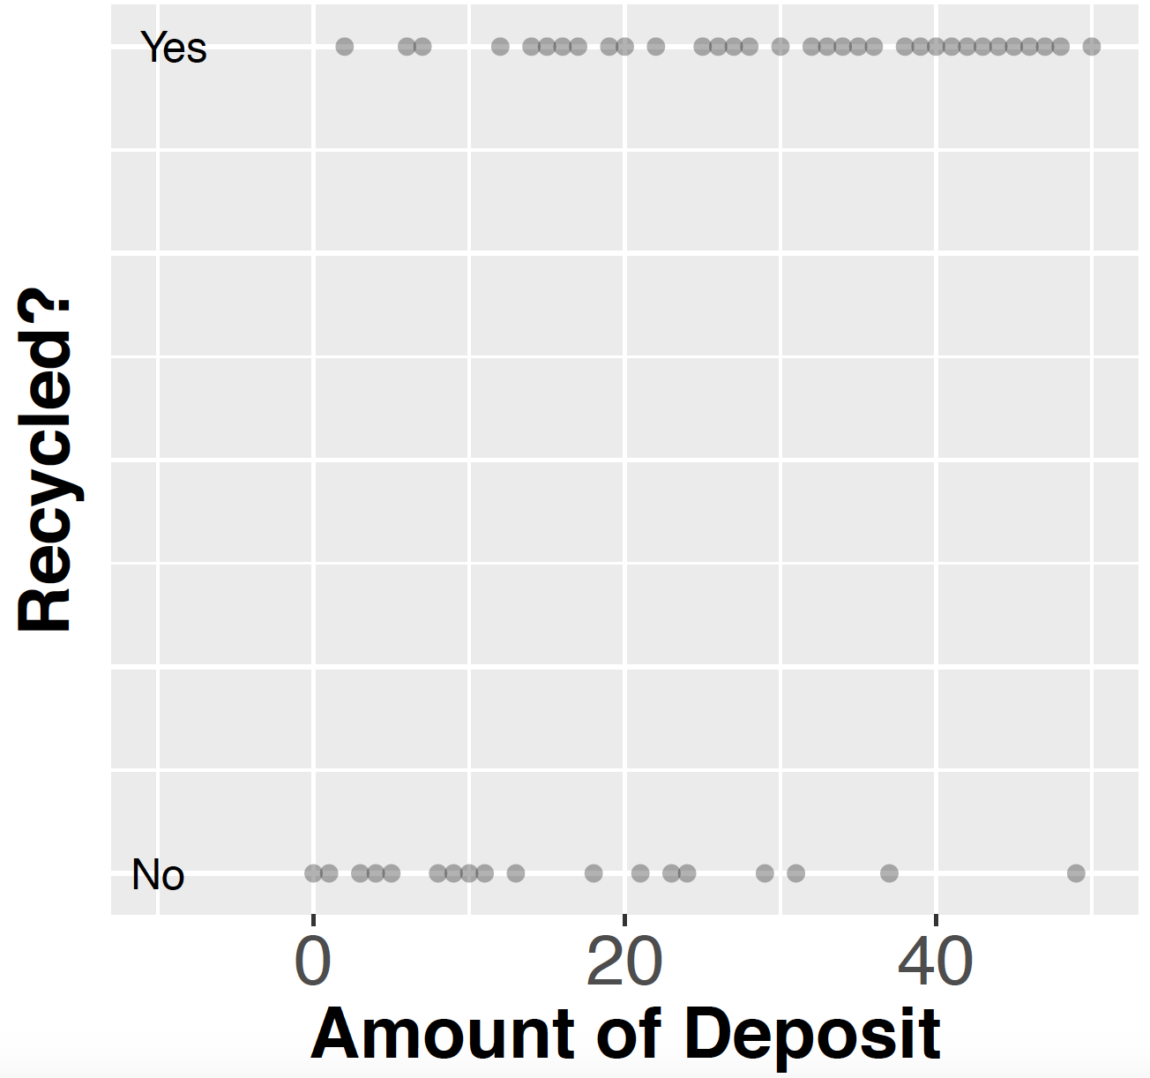

Slide 5
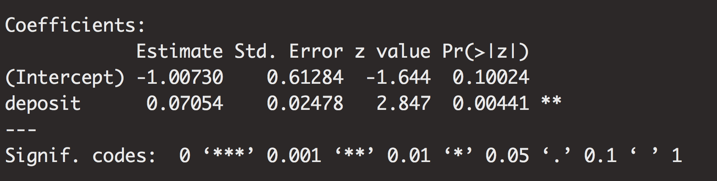
A logistic regression will allow us to test this relationship:
In LOGISTIC REGRESSION, we need to exponentiate our coefficients to get Odds Ratio. In this example, e^{0.07054}=1.0731
A logistic regression reveals that there is a significant association between deposit amount and recycling (OR=1.0731, p = 0.004).
As deposit amount increases by 1 cent, the odds that a bottle is returned is expected to increase by a factor of 1.0731.

Slide 6
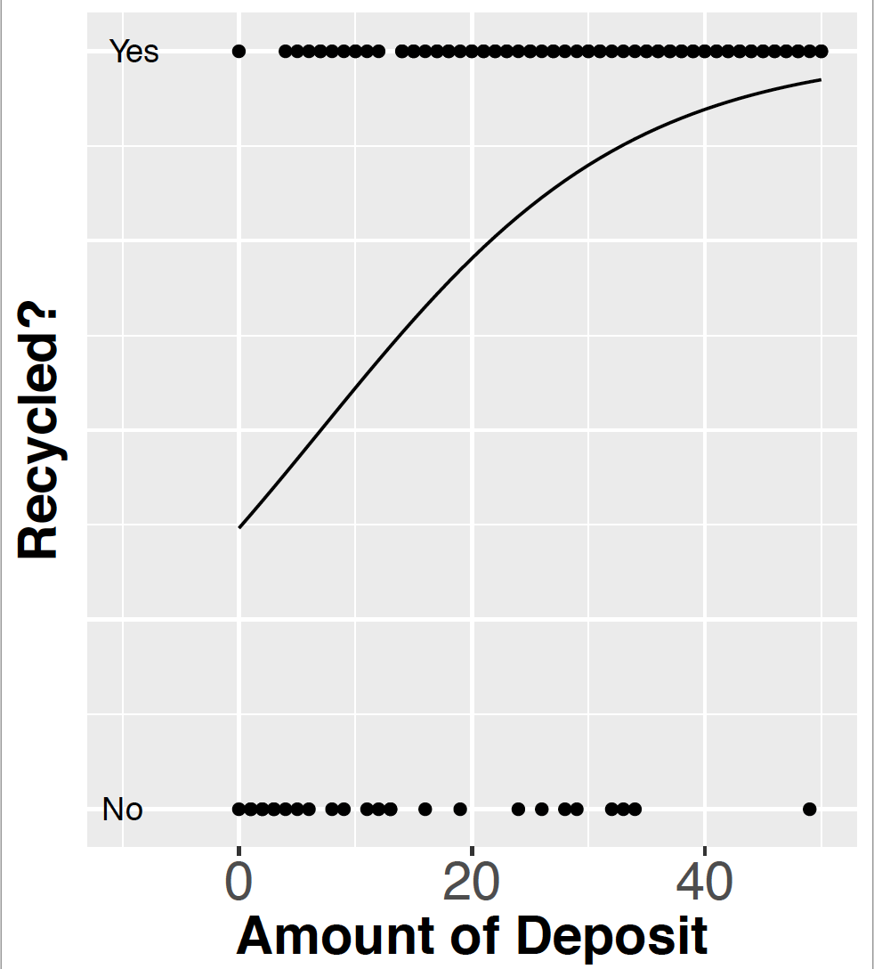
Which graphically looks like:
1.0
0.75
Probability of Recycled
0.5
0.25
0

Slide 7
Now suppose we want to see how material type (plastic or aluminum) seems to relates to the likelihood it is recycled, in addition to deposit amount.
A new model is run with material type and deposit amount as predictors and with whether it was recycled as the response variable.
The output is as follows:

Slide 8
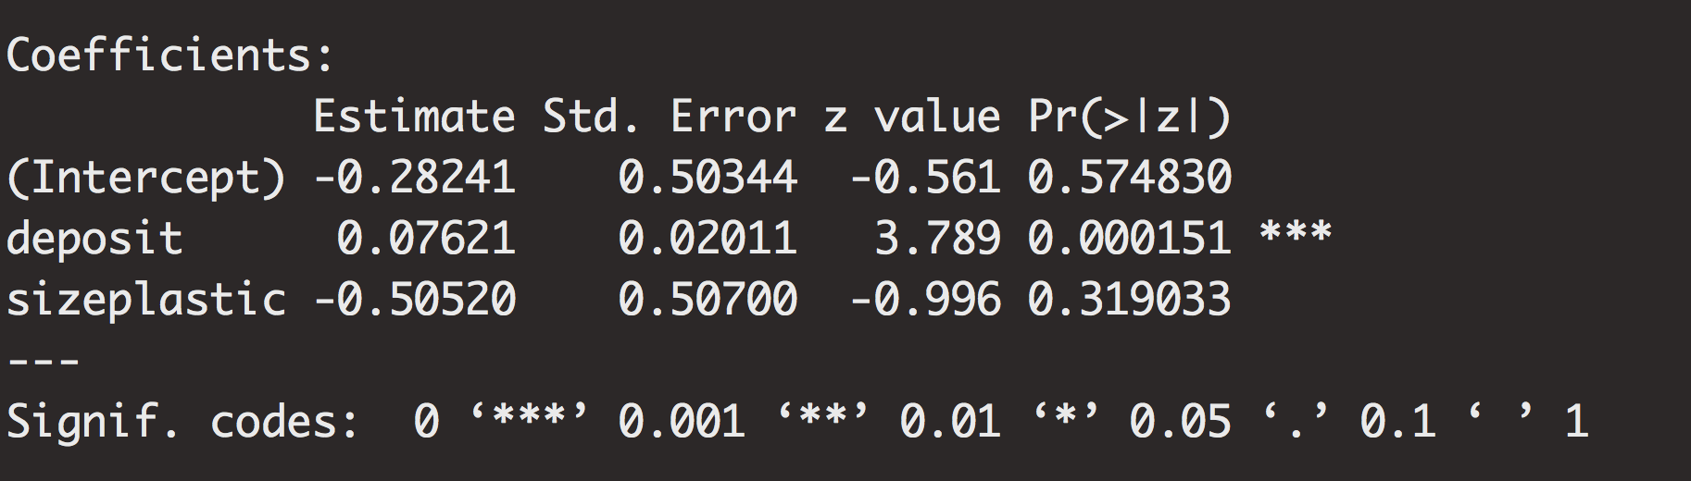
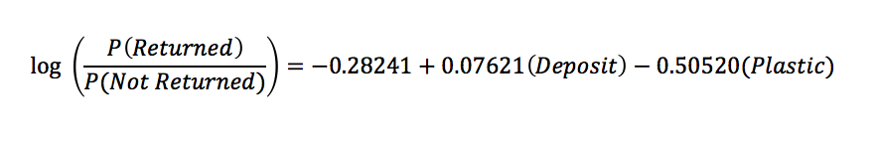
Interpretations:
The deposit amount is significantly and positively related to likelihood of return (B=0.076, p-value=0.00015). In particular, the odds of a bottle being returned increase by a factor of 1.079 (or e^{0.0761}) for each additional cent increase.
The material type (plastic versus aluminum) does not significantly relate to likelihood of return.

Slide 9
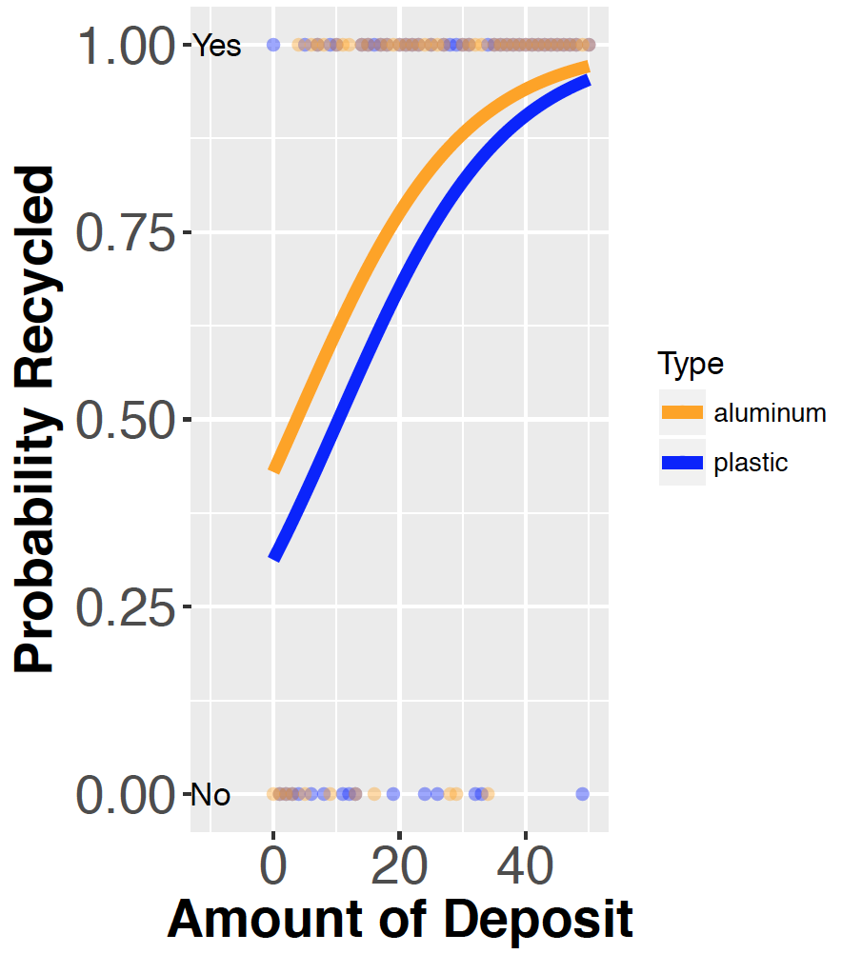
Which graphically looks like:
Note:
Our model on the previous
slide tells us that the orange and
blue lines do not vary significantly.

